Slide 1

Investment Banking Strategies and Key Issues
Kaan Sarıaydın
23rd November 2009, Bilgi University
www.kaansariaydin.com
kaan.sariaydin@gmail.com

Slide 2
What is an Investment Bank?
An Investment Bank is a financial institution that raises capital, trades securities and manages corporate mergers and acquisitions. Investment banks profit from companies and governments by raising money through issuing and selling securities in capital markets (both equity, debt) and insuring bonds (e.g. selling credit default swaps), and providing advice on transactions such as mergers and acquisitions. A majority of investment banks offer strategic advisory services for mergers, acquisitions, divestiture or other financial services for clients, such as the trading of derivatives, fixed income, foreign exchange, commodity, and equity securities.

Slide 3

Investment vs. Commercial Bank
The Glass–Steagall Act, initially created in the wake of the Stock Market Crash of 1929, prohibited banks from both accepting deposits and underwriting securities, and led to segregation of investment banks from commercial banks. Glass–Steagall was effectively repealed for many large financial institutions by the Gramm–Leach–Bliley Act Until 1999, the United States maintained a separation between investment banking and commercial banks. Other industrialized countries (including G7 countries) have not maintained this separation historically.
IB vs. CB
Glass-Steagall Act (1933)
Gramm-Leach-Bliley Act (1999)
Bail-outs (2008)

Slide 4

“Everything should be made as simple as possible, but not simpler.” - Albert Einstein

Slide 5
Revenue-Generating Activities
Financial Engineering
Zero Coupon Securities
Mortgage-Backed-Securities
Derivative Products
Other Revenue-Generating Activities
Investment Management (PWM, PCS and Asset Management))
Merchant Banking (Private Equity and Venture Capital)
Consulting
Transaction Banking (Prime Brokerage)
Primary Market Making
Corporate Finance
Municipal Finance
Treasury and Agency Finance
Secondary Market Making
Dealer Activities
Brokerage Activities
Trading
Arbitrage
Proprietary
Corporate Restructuring
Expansion
Contraction
Ownership and Control
These are all Front Office Activities

Slide 6
Buy Side vs. Sell Side
Buy Side
Dealing with the pension funds, mutual funds, hedge funds, and the investing public who consumed the products and services of the sell-side in order to maximize their return on investment
Sell Side
Trading securities for cash or securities (i.e., market-making, facilitating transactions)
The promotion of securities (i.e., research, underwriting, etc.)

Slide 7

Support Activities
Middle Office
Risk Management (Market and Credit Risk)
Corporate Treasury (Funding and Liquidity Risk Monitoring)
Financial Controling
Corporate Strategy
Compliance
Back Office
Operations (Clearing)
Information Technology

Slide 8

Chinese Walls
Potential conflicts of interest may arise between different parts of a bank, creating the potential for financial movements that could be market manipulation. Authorities that regulate investment banking (the FSA in the UK and the SEC in the US) require that banks impose a Chinese wall which prohibits communication between investment banking on one side and equity research and trading on the other.

Slide 9
Corporate Finance Transactions
Equity Offerings
Initial Public Offering (IPO)
Secondary Market Offering (SEO)
Mergers and Acquisitions
Takeover
Leverage
Leveraged Buyouts
Bond Offering

Slide 10
Initial Public Offering
An IPO is the process by which a private company transforms itself into a public company. The company offers, for the first time, shares of its equity (ownership) to the investing public. These shares subsequently trade on a public stock exchange
Why IPO?
to raise cash to fund the growth
cash out partially or entirely by selling ownership
to diversify net worth or to gain liquidity
Concerns:
Going Public is not a slum dunk
Firms that are too small, too stagnant or have poor growth prospects will - in general - fail to find an investment bank willing to underwrite

Slide 11
Pros and Cons of an IPO
Advantages
Disadvantages
Stronger Capital Base
Increases Financing prospects
Better situated for acquisitions
Owner Diversification
Executive Compensation
Increase company prestige
Short-term growth pressure
Disclosure and Confidentiality
Costs – initial and ongoing
Restrictions on Management
Loss of personal benefits
Trading Restrictions

Slide 12
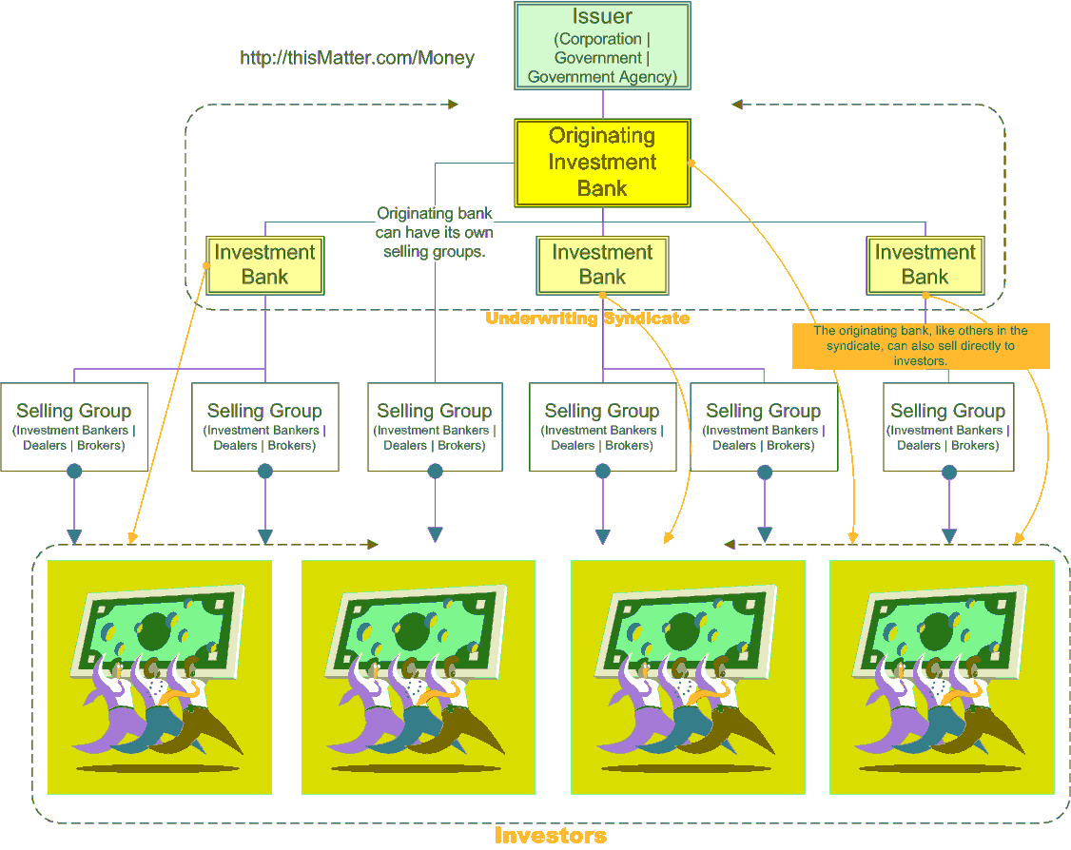
Initial Public Offering Process

Slide 13
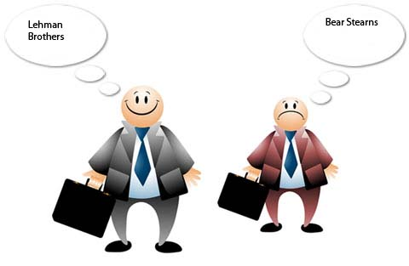
1st Step of an IPO
The Pitch (Pitchbook)
Originating/ Hiring the managers
(“Beauty Contest”)/ Pitching
Making a Valuation (mix of art and science)
Highest Valuation vs. Best-qualified manager
Determine structuring and distribution
The Pitchbook includes:
• the bank's reputation, which can lend the offering an aura of respectability
• the performance of other IPOs managed by the bank
• the prominence of a bank's research analyst in the industry, which can tacitly guarantee that the new
public stock will receive favorable coverage by a listened-to stock expert
• the bank's expertise as an underwriter in the industry

Slide 14
2nd Step of an IPO
Underwriting (reason: size)
form the syndicate and selling group for joint distribution of the offering
Members of the syndicate make a firm commitment to distribute a certain percentage of the entire offering and are held financially responsible for any unsold portions
Selling groups (“best effort”) of chosen brokerages, are formed to assist the syndicate members meet their obligations
most common type of underwriting, firm commitment, the managing underwriter makes a commitment to the issuing corporation to purchase all shares being offered. If part of the new issue goes unsold, any losses are distributed among the members of the syndicate.
Many underwriters require that your company is generating sales of $10 to $20 million annually with profits of $1 million. That your product is on the "leading edge" and that you have an experienced, proven top management team and can show future growth rates of at least 25% annually for the next five years.

Slide 15
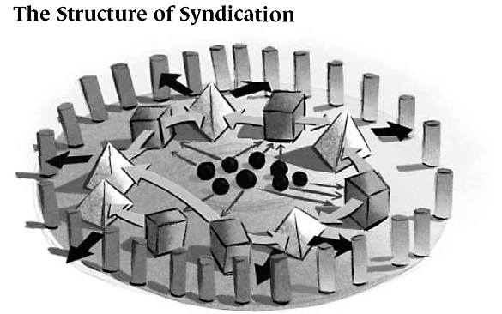
The Syndicate
Vital link between salespeople and corporate finance. Syndicate exists to facilitate the placing of securities in a public offering, a knock-down drag-out affair between and among buyers of offerings and the investment banks managing the process. In a corporate or municipal debt deal, syndicate also determines the allocation of bonds.

Slide 16
Pricing of an IPO
Lead managers help to decide on an appropriate price at which the shares should be issued.
There are two ways in which the price of an IPO can be determined:
the company, with the help of its lead managers, fixes a price or
the price is arrived at through the process of book building.
Book Building is a process to aid price and demand discovery. It is a mechanism where, during the period for which the book for the offer is open, the bids are collected from investors at various prices, which are within the price band specified by the issuer. The process is directed towards both the institutional as well as the retail investors. The issue price is determined after the bid closure based on the demand generated in the process. In case of oversubscription the greenshoe (over-allotment) option is triggered. It can vary in size up to 15% of the original number of shares offered

Slide 17
3rd Step of an IPO
Due Diligence and Drafting
understanding the company's business as well as possible scenarios (Due Diligence)
filing the legal Documents as required by the Regulator (Prospectus)
Registration Statement:
Business product/service/markets
Company Information
Risk Factors
Proceeds Use
Officers and Directors
Related party transactions
Identification of your principal shareholders
Audited financials

Slide 18
4th Step of an IPO
Marketing
“Roadshow” or “Baby Sitting”
marketing phase ends with the placement of the stock
gathering "indications of interest"
An indication of interest does not obligate or bind the customer to purchase the issue, since all sales are prohibited until the security has cleared registration.
final prospectus is issued
The final prospectus contains all of the information in the preliminary prospectus (plus any amendments), as well as the final price of the issue, and the underwriting spread.

Slide 19
The Process of Going Public
Phase 1: Hiring the Managers
• Pitching/Beauty contests
• Selecting the managers in the deal
Phase 2: Due Diligence & Drafting
• Due diligence
• Drafting the prospectus
• Meeting at the printer and filing the prospectus
Phase 3: Marketing
• Designing the roadshow - slides and presentation
• Amending the prospectus per comments from the SEC
• Managers set up roadshow meetings
• Roadshow begins
• Roadshow ends and stock is priced
End: Stock Begins Trading!

Slide 20
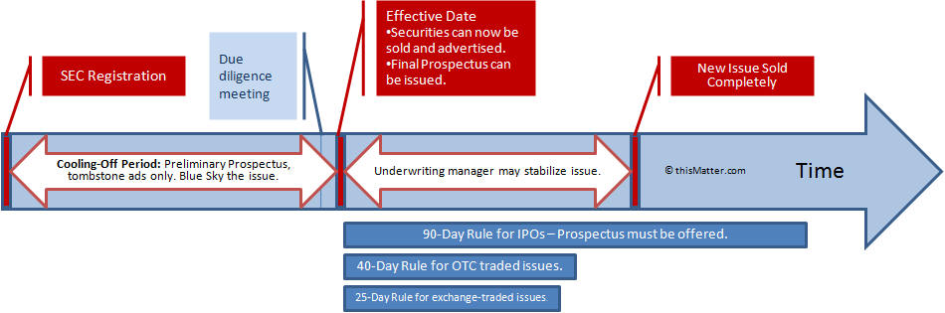
Timelline for an IPO (example:US)

Slide 21
Fees of an IPO
The price paid to the issuer is known as the underwriting proceeds. The spread between the POP (Public Offering Price ) and the underwriting proceeds is split into the following components:
Manager's Fee - goes to the managing underwriter for negotiating and managing the offering. (10% - 20% of the spread)
Underwriting Fee - goes to the managing underwriter and syndicate members for assuming the risk of buying the securities from the issuing corporation. (20% - 30% of the spread)
Selling Concession - goes to the managing underwriter, the syndicate members, and to selling group members for placing the securities with investors. (50% - 60% of the spread)
Often the managing underwriter will need to stabilize the price to keep it from falling too far below the POP.

Slide 22
IPO Experience (Tricks)
For most investors, buying shares of a "hot" IPO at the POP is next to impossible. Starting with the managing underwriter and all the way down to the investor, shares of such attractive new issues are allocated based on preference. Most brokers reserve whatever limited allocation they receive for only their best customers.
In fact, the old joke about IPO's is that if you get the number of shares you ask for, give them back, because it means nobody else wants it.

Slide 23
Secondary Market Offering (SEO)
A follow-on offering or SEO is an issuance of stock subsequent to the company's IPO. A SEO can be either of two types (or a mixture of both): dilutive ("new" shares ) and non-dilutive ("old" shares ) (as rights issue). Furthermore it could be a cash issue or a capital increase in return for stock.
The Process: The SEO process changes little from that of an IPO, and actually is far less complicated. Since underwriters have already represented the company in an IPO, a company often chooses the same managers, thus making the hiring the manager or beauty contest phase much simpler. Also, no valuation is required (the market now values the firm's stock), a prospectus has already been written, and a roadshow presentation already prepared. Modifications to the prospectus and the roadshow demand the most time in a SEO
Market Reaction: What happens when a company announces a secondary offering indicates the market's tolerance for additional equity. Because more shares of stock "dilute" the old shareholders, the stock price usually drops on the announcement of a SEO. Dilution occurs because earnings per share (EPS) in the future will decline, simply based on the fact that more shares will exist post-deal. And since EPS drives stock prices, the share price generally drops.

Slide 24
Bond Offerings
The reasons for issuing bonds rather than stock are various. Perhaps the stock price of the issuer is down, and thus a bond issue is a better alternative. Or perhaps the firm does not wish to dilute its existing shareholders by issuing more equity. These are both valid reasons for issuing bonds rather than equity. Sometimes in down markets, investor appetite for public offerings dwindles to the point where an equity deal just could not get done (investors would not buy the issue).
The bond offering process resembles the IPO process. The primary difference lies in:
(1) the focus of the prospectus (a prospectus for a bond offering will emphasize the company's stability and steady cash flow, whereas a stock prospectus will usually play up the company's growth and expansion opportunities), and
(2) the importance of the bond's credit rating (the company will want to obtain a favorable credit rating from a debt rating agency like S&P or Moody's, with the help of the credit department of the investment bank issuing the bond; the bank's credit department will negotiate with the rating agencies to obtain the best possible rating). Clearly, a firm issuing debt will want to have the highest possible bond rating, and hence pay a low interest rate.

Slide 25
Relationship of Different Divisions
Corporate Finance
Syndicate
Sales
Trading

Slide 26




Mergers & Acquisitions

Slide 27
Mergers & Acquisitions
Acquisition: Acquisition - When a larger company takes over another (smaller firm) and clearly becomes the new owner. Typically, the target company ceases to exist post-transaction (from a legal corporation point of view) and the acquiring corporation swallows the business. The stock of the acquiring company continues to be traded.
Merger: when two firms, often of about the same size, agree to go forward as a single new company rather than remain separately owned and operated. This kind of action is more precisely referred to as a "merger of equals". Both companies' stocks are surrendered and new company stock is issued in its place.
In practice, however, actual mergers of equals don't happen very often. Usually, one company will buy another and, as part of the deal's terms, simply allow the acquired firm to proclaim that the action is a merger of equals, even if it is technically an acquisition.
Whether a purchase is considered a merger or an acquisition really depends on whether the purchase is friendly or hostile and how it is announced. In other words, the real difference lies in how the purchase is communicated to and received by the target company's board of directors, employees and shareholders. It is quite normal though for M&A deal communications to take place in a so called 'confidentiality bubble' whereby information flows are restricted due to confidentiality agreements

Slide 28


Slide 29
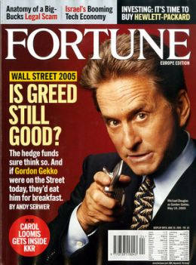
Acquisitions
Acquisition, also known as a Takeover or a Buyout
In the 1980s, hostile takeovers and LBO acquisitions were all the rage. Companies sought to acquire others through aggressive stock purchases and cared little about the target company's concerns.
When a public company acquires another public company, the target company's stock often shoots through the roof while the acquiring company's stock often declines. Why? One must realize that existing shareholders must be convinced to sell their stock. Few shareholders are willing to sell their stock to an acquirer without first being paid a premium on the current stock price. In addition, shareholders must also capture a takeover premium to relinquish control over the stock. The large shareholders of the target
company typically demand such an extraction. For example, the management of the selling company may require a substantial premium to give up control of their firm.

Slide 30
Types of Acquisitions
Friendly: the companies cooperate in negotiations
Hostile: target is unwilling to be bought or the target's board has no prior knowledge of the offer
Reverse Takeover: a smaller firm will acquire management control of a larger company and keep its name for the combined entity.
Reverse Merger: a deal that enables a private company to get publicly listed in a short time period. It occurs when a private company that has strong prospects and is eager to raise financing buys a publicly listed shell company, usually one with no business and limited assets.
Achieving acquisition success has proven to be very difficult, while various studies have shown that 50% of acquisitions were unsuccessful. The acquisition process is very complex, with many dimensions influencing its outcome.

Slide 31
Tactics against Hostile Takeovers
Back-end
Bankmail
Crown Jewel Defense
Flip-in
Flip-over
Golden Parachute
Gray Knight
Greenmail
Jonestown Defense
Killer bees
Leveraged recapitalization
Lobster trap
Lock-up provision
Macaroni Defense
Nancy Reagan Defense
Non-voting stock
Pac-Man Defense
Pension parachute
People Pill
Poison pill
Poison Put
Safe Harbor
Scorched-earth defense
Shark Repellent
Standstill agreement
Staggered board of directors
Targeted repurchase
Top-ups
Treasury stock
Trigger
Voting plans
White knight
White squire
Whitemail

Slide 32
Categories of Mergers
Congeneric: firms in the same general industry, but no mutual buyer/customer or supplier relationship, such as a merger between a bank and a leasing company. (i.e. Prudential's acquisition of Bache & Company)
Conglomerate: companies that have no common business areas.
Product-extension merger: Two companies selling different but related products in the same market (eg: a cone supplier merging with an ice cream maker).
Consolidation mergers: a brand new company is formed and both companies are bought and combined under the new entity.
Accretive mergers: are those in which an acquiring company's earnings per share (EPS) increase. An alternative way of calculating this is if a company with a high price to earnings ratio (P/E) acquires one with a low P/E.
Dilutive mergers: are the opposite of above, whereby a company's EPS decreases. The company will be one with a low P/E acquiring one with a high P/E.
The occurrence of a merger often raises concerns in antitrust circles. Regulatory bodies such may investigate anti-trust cases for monopolies dangers, and have the power to block mergers.

Slide 33
Motives behind M&A
Economy of Scale
Increased Revenue or Market Share
Cross-Selling
Synergy
Taxation
Diversification
Vertical Integration
Managers’s Hubris: manager's overconfidence about expected synergies from M&A which results in overpayment for the target company
Empire-building: Managers have larger companies to manage and hence more power.
Manager's compensation: certain executive management teams had their payout based on the total amount of profit of the company, instead of the profit per share, which would give the team a perverse incentive to buy companies to increase the total profit while decreasing the profit per share

Slide 34
Effects of M&A
Reasons for frequent failure of M&A: Despite the goal of performance improvement, results from mergers and acquisitions (M&A) are often disappointing. Numerous empirical studies show high failure rates of M&A deals. Studies are mostly focused on individual determinants. The literature therefore lacks a more comprehensive framework that includes different perspectives. M&A performance is a multi-dimensional function. For a successful deal, the following key success factors should be taken into account:
Strategic logic which is reflected by six determinants: market similarities, market complementarities, operational similarities, operational complementarities, market power, and purchasing power..
Organizational integration which is reflected by three determinants: acquisition experience, relative size, cultural compatibility.
Financial / price perspective which is reflected by three determinants: acquisition premium, bidding process, and due diligence.
Post-M&A performance is measured by synergy realization, relative performance (compared to competition), and absolute performance.
A study published in the July/August 2008 issue of the Journal of Business Strategy suggests that mergers and acquisitions destroy leadership continuity in target companies’ top management teams for at least a decade following a deal. The study found that target companies lose 21 percent of their executives each year for at least 10 years following an acquisition – more than double the turnover experienced in non-merged firms.

Slide 35
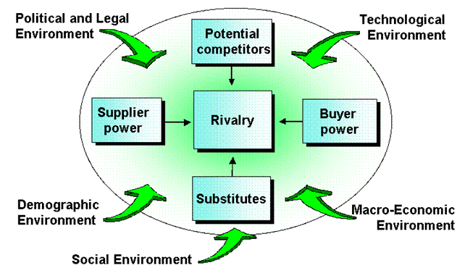
The Role of the Macro-Environment
The completion of a merger does not ensure the success of the resulting organization; indeed, many mergers (in some industries, the majority) result in a net loss of value due to problems. Correcting problems caused by incompatibility—whether of technology, equipment, or corporate culture— diverts resources away from new investment, and these problems may be exacerbated by inadequate research or by concealment of losses or liabilities by one of the partners. Overlapping subsidiaries or redundant staff may be allowed to continue, creating inefficiency, and conversely the new management may cut too many operations or personnel, losing expertise and disrupting employee culture.
These problems are similar to those encountered in takeovers. For the merger not to be considered a failure, it must increase shareholder value faster than if the companies were separate, or prevent the deterioration of shareholder value more than if the companies were separate.

Slide 36
M&A Advisory Services
M&A advising is highly profitable, and there are many possibilities for types of transactions.
Perhaps a small private company's owner/manager wishes to sell out for cash and retire.
Or perhaps a big public firm aims to buy a competitor through a stock swap.
Whatever the case, M&A advisors come directly from the corporate finance departments of investment banks.
Unlike public offerings, merger transactions do not directly involve salespeople, traders or research analysts.
In particular, M&A advisory falls onto the laps of M&A specialists and fits into one of either two buckets: seller representation or buyer representation (also called target representation and acquirer representation).

Slide 37

Representing the Target
An I-bank that represents a potential seller has a much greater likelihood of completing a transaction (and therefore being paid) than an I-bank that represents a potential acquirer. Also known as sell-side work, this type of advisory assignment is generated by a company that approaches an investment bank and asks the bank to find a buyer of either the entire company or a division. Often, sell-side representation comes when a company asks an investment bank to help it sell a division, plant or subsidiary operation. Generally speaking, the work involved in finding a buyer includes writing a Selling Memorandum and then
contacting potential strategic or financial buyers of the client. If the client hopes to sell a semiconductor plant, for instance, the I-bankers will contact firms in that industry, as well as buyout firms that focus on purchasing technology or high-tech manufacturing operations.

Slide 38

Representing the Acquirer
In advising sellers, the I-bank's work is complete once another party purchases the business up for sale, i.e., once another party buys your client's company or division or assets. Buy-side work is an entirely different animal. The advisory work itself is straightforward: the investment bank contacts the firm their client wishes to purchase, attempts to structure a palatable offer for all parties, and make the deal a reality. However, most of these proposals do not work out; few firms or owners are willing to readily sell their business. And because the I-banks primarily collect fees based on completed transactions, their work often goes unpaid.
Acquisition searches can last for months and produce nothing except associate and analyst fatigue as they repeatedly build merger models and work all-nighters. Deals that do get done, though, are a boon for the I-bank representing the buyer because of their enormous profitability.

Slide 39
The Lehman Scale
The Lehman Scale is a traditional schedule of advisers’ chargeable fees. The scale is based on the transaction size of the deal, and is normally payable by the vendor(s) of the business once the purchaser's funds have cleared.
5% on the first $1,000,000, plus
4% on the second $1,000,000, plus
3% on the third $1,000,000, plus
2% on the fourth $1,000,000, plus
1% on everything above $4,000,000
The Lehman Scale was widely used in the 1970s, 1980s and 1990s. Its popularity has waned recently, mainly because there is little incentive for the adviser to "go the extra mile" in achieving a higher sale value.

Slide 40
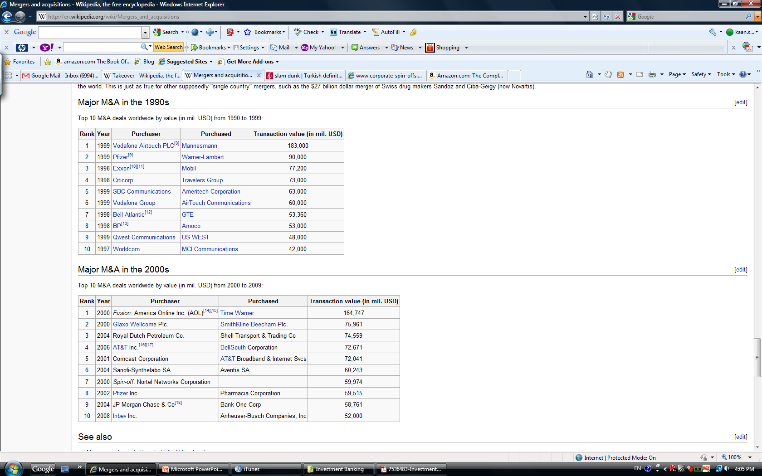
Major M&A in the 1990s

Slide 41
Major M&A in the 2000s

Slide 42


Leveraged Buyouts
A leveraged buyout (or LBO, or highly-leveraged transaction (HLT), or "bootstrap" transaction) occurs when a financial sponsor acquires a controlling interest in a company's equity and where a significant percentage of the purchase price is financed through leverage (borrowing). The assets of the acquired company are used as collateral for the borrowed capital, sometimes with assets of the acquiring company. The bonds or other paper issued for leveraged buyouts are commonly considered not to be investment grade because of the significant risks involved.

Slide 43
Why LBO?
The investor itself only needs to provide a fraction of the capital for the acquisition
Assuming the economic internal rate of return on the investment exceeds the weighted average interest rate on the acquisition debt, returns to the financial sponsor will be significantly enhanced.
As transaction sizes grow, the equity component of the purchase price can be provided by multiple financial sponsors "co-investing" to come up with the needed equity for a purchase. Likewise, multiple lenders may band together in a "syndicate" to jointly provide the debt required to fund the transaction. Today, larger transactions are dominated by dedicated private equity firms and a limited number of large banks with "financial sponsors" groups.
As a percentage of the purchase price for a LBO target, the amount of debt used to finance a transaction varies according the financial condition and history of the acquisition target, market conditions, the willingness of lenders to extend credit as well as the interest costs and the ability of the company to cover those costs. Typically the debt portion of a LBO ranges from 50%-85% of the purchase price, but in some cases debt may represent upwards of 95% of purchase price. Between 2000-2005 debt averaged between 59.4% and 67.9% of total purchase price for LBOs in the United States.

Slide 44
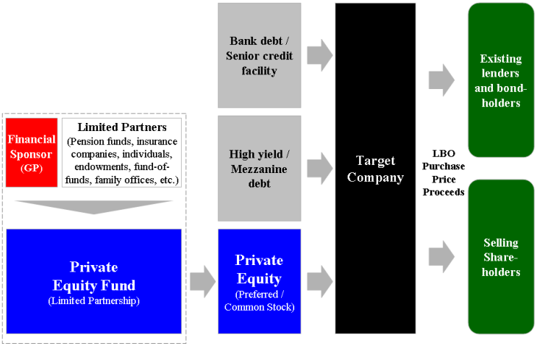
Basic Structure of a LBO Transaction

Slide 45
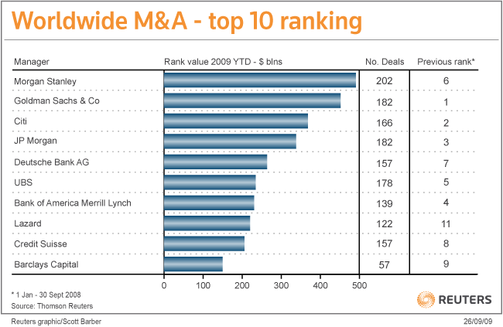
As of October 2009

Slide 46

Sales & Trading

Slide 47
Sales
Institutional Sales: manages the bank's relationships with institutional money managers such as mutual funds or pension funds. It is often called research sales, as salespeople focus on selling the firm's research to institutions.
Retail Brokerage (account executives, financial advisors or financial consultants ): involves managing the account portfolios for individual investors - usually called retail investors. Brokers give advice to their clients regarding stocks to buy or sell, and when to buy or sell them.
Private Client Services (PCS): A cross between institutional sales and retail brokerage, PCS focuses on providing money management services to extremely wealthy individuals.
The Sales-trader: A hybrid between sales and trading, sales-traders essentially operate in a dual role as both salesperson and block trader. sales-traders typically cover the highlights and the big picture and they speak to the in-house traders of the buy-side. When specific questions arise, a sales-trader will often refer a client to the research analyst.
Sales is a core area of any investment bank, comprising the vast majority of people and the relationships that account for a substantial portion of any investment banks revenues.

Slide 48
The Role of Sales in an IPO
Salespeople help place the offering with various money managers.
To give you a breakdown, IPOs typically cost the company going public
7 percent of the gross proceeds raised in the offering. That 7 percent is divided between sales, syndicate and investment banking (i.e. corporate finance) in approximately the following manner:
• 60 percent to Sales
• 20 percent to Corporate Finance
• 20 percent to Syndicate
(If there are any deal expenses, those get charged to the syndicate account and the profits left over from syndicate get split between the syndicate group and the corporate finance group.)
As we can see from this breakdown, the sales department stands the most to gain from an IPO. Their involvement does not begin, however, until a week or two prior to the roadshow.

Slide 49

Trading

Slide 50
Trading
Market Making: quotes both a buy and a sell price in a financial instrument, hoping to make a profit on the bid/offer spread.
Execution/Broker: Execution-only, which means that the broker will only carry out the client's instructions to buy or sell.
Proprietary Trading: firm's traders actively trade financial instruments with its own money as opposed to its customers' money, so as to make a profit for itself (riskier and results in more volatile profits).
Index Arbitrage
Statistical Arbitrage
Merger (Risk) Arbitrage
Volatility Arbitrage
Macro Trading
Delta Neutral/ Long-Short Strategy

Slide 51

Importance of Trading
Salespeople provide the clients for traders, and traders provide the products for sales. Traders would have nobody to trade for without sales, but sales would have nothing to sell without traders.
Understanding how a trader makes money and how a salesperson makes money should explain how conflicts can arise.
Trading can make or break an investment bank. Without traders to execute buy and sell transactions, no public deal would get done, no liquidity would exist for securities, and no commissions or spreads would accrue to the bank. Traders carry a "book" accounting for the daily revenue that they generate for the firm -down to the dollar!

Slide 52
Tools of a Trader
Fundamental Analysis
Technical Analysis
Gut Feeling
$$$$$$

Slide 53
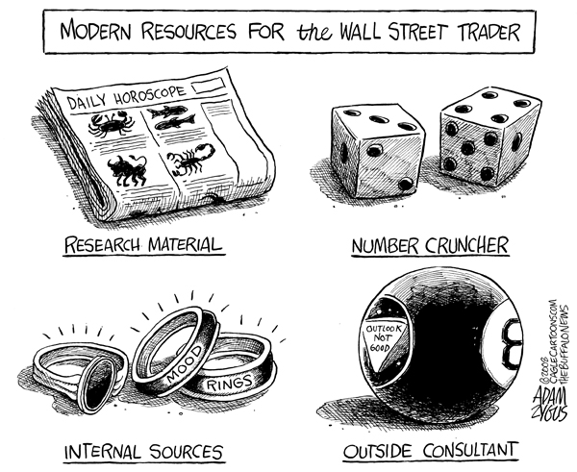
Real Tools of a Trader

Slide 54
Syndicate
What does the syndicate department at an investment bank do?
Syndicate usually sits on the trading floor, but syndicate employees don't trade securities or sell them to clients. Neither do they bring in clients for corporate finance. What syndicate does is provide a vital role in placing stock or bond offerings with buysiders, and truly aim to find the right offering price that satisfies both the company, the salespeople, the investors and the corporate finance bankers working the deal.
In any public offering, syndicate gets involved once the prospectus is filed with the SEC. At that point, Syndicate associates begin to contact other investment banks interested in being underwriters in the deal. -> Syndicate Pros must be Politicians!
The Book: a listing of all investors who have indicated interest in buying stock in an offering. Investors place orders by telling their respective salesperson at the investment bank or by calling the syndicate department of the lead manager. Only the lead manager maintains the book in a deal.
Main Functions: Syndication, Book Building, Pricing and Allocation

Slide 55

Research
Intermediaries between companies and the buy-side, corporate finance and sales and trading, research analysts form the hub of investment banks.
Analysts produce research ideas.
Managers of research reports and
the experts on their industries to the
outside world.
Research analysts appear to be statisticians, it often comes closer a diplomat or salesperson.
Corporate finance bankers press research analysts to be banker-friendly. Salespeople yearn for new stock ideas they can use to solicit trades from clients. Investors demand that research analysts write unbiased research, while companies wish for the best rating possible. Although within the department, research is often less political than corporate finance, those in research face more external pressure than any other area in investment banking.

Slide 56

The Future of Investment Banking
Financial Crisis and Effects!
Sheer Size of Accumulated Losses
Toxic Assets
No Mark-to-Market
Leverage and Balance Sheet overstretch
Cybernation and more efficient web-based solutions
Bonus Structure vs. Malus Structure
Socialization of Losses vs. Individualization of Profits
Constant Margin Pressure
End of the Finance Cult!

Slide 57

Thank you very much!.................www.kaansariaydin.com

